Slide 1


TTRS for parents and carers
Multiplication at Highfield Farm Primary School

Slide 2
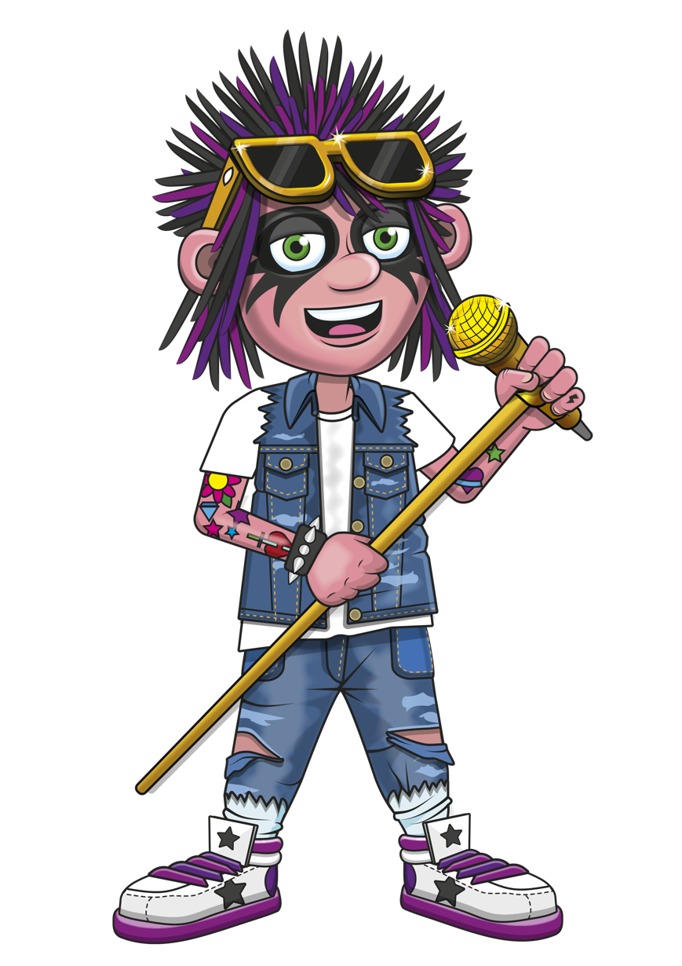






AGENDA
Introduction to TT rock stars
Getting to know the platform
Next steps (5 mins)
Feedback

Slide 3

INTRODUCTION
An amazing learning platform that has huge potential.
TTRS is a safe, online platform to support your children with their multiplication learning.
The school subscribes to TTRS which means that you can also use it at home.

Slide 4

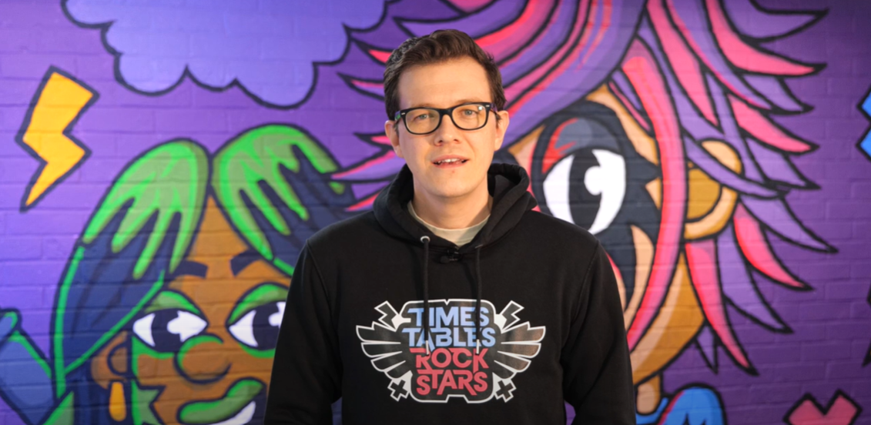

Why are times tables so important?

Slide 5
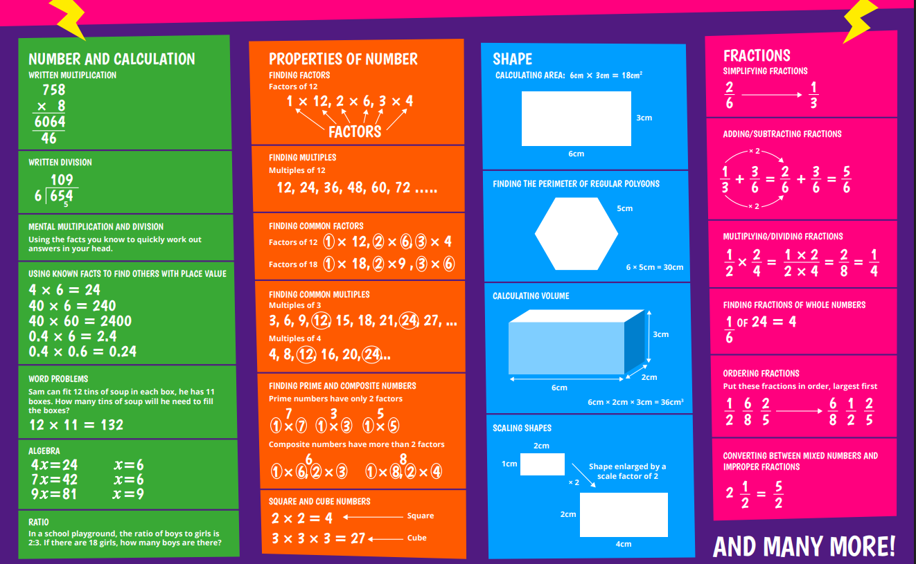
Why are times tables so important?

Slide 6

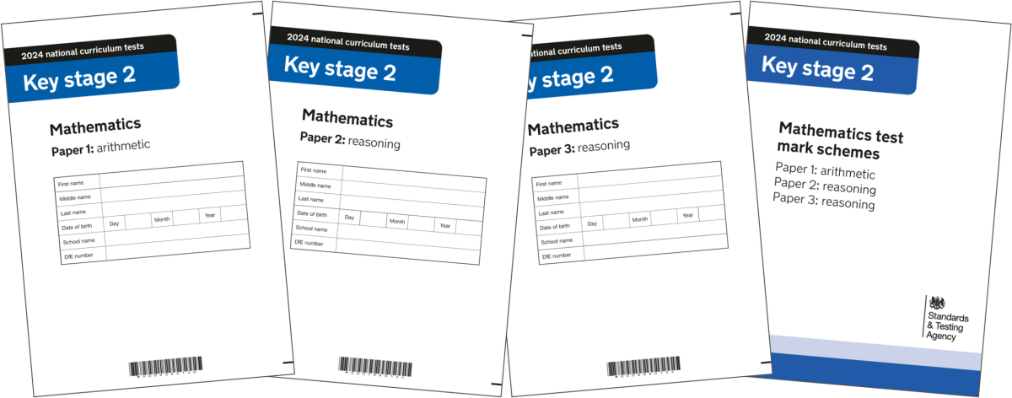
Knowing your times tables and the KS2 curriculum
It will support them in so many areas of the maths curriculum.
Not just in KS2 but also in secondary school also.

Slide 7
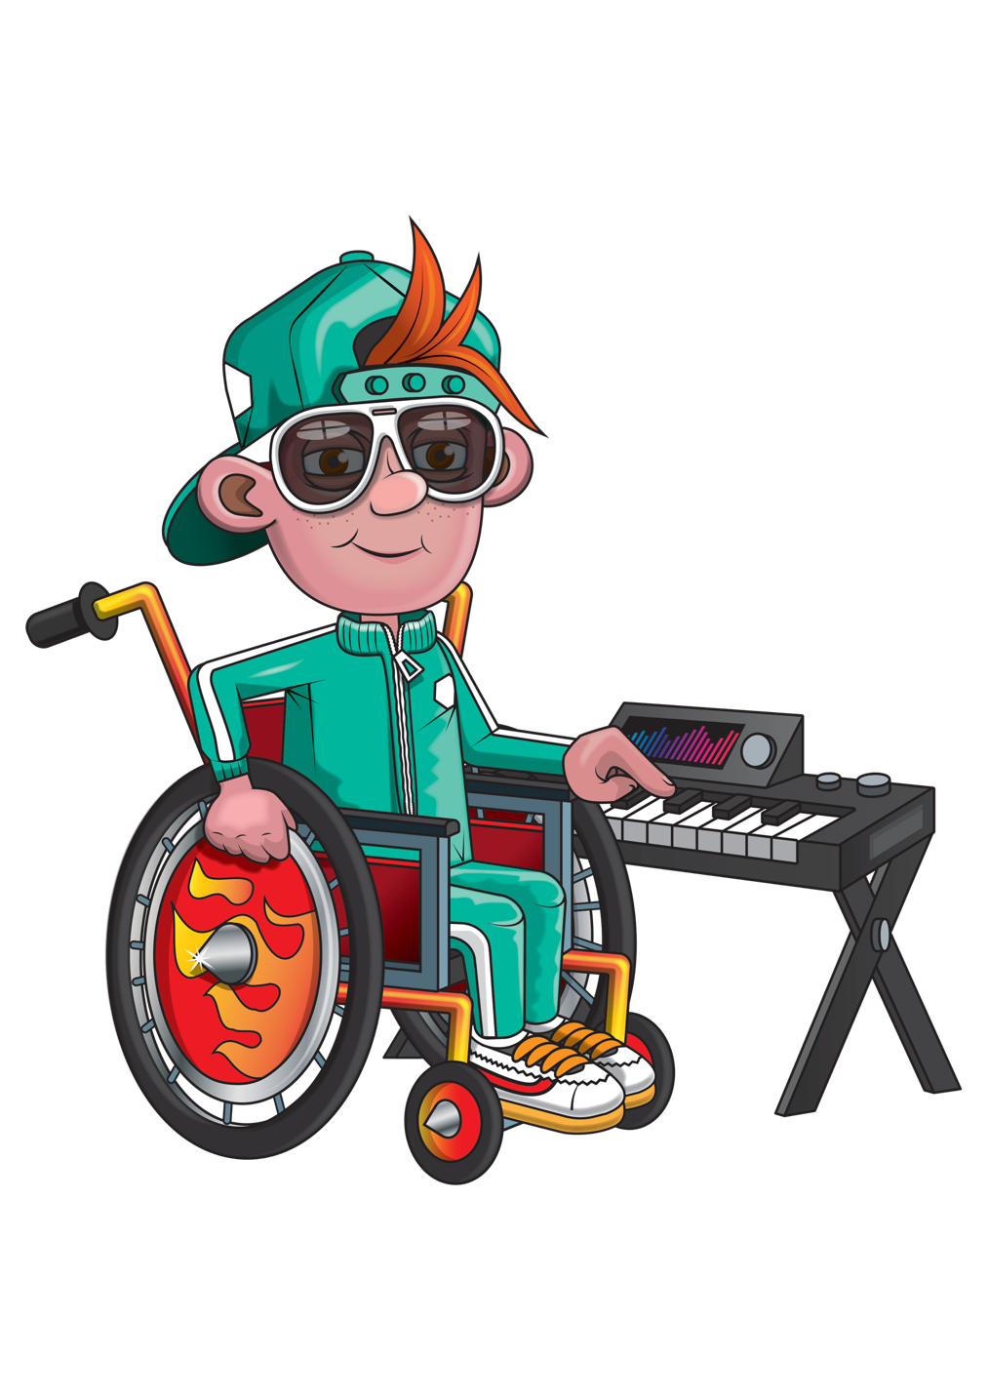


What is TTRS?

Slide 8



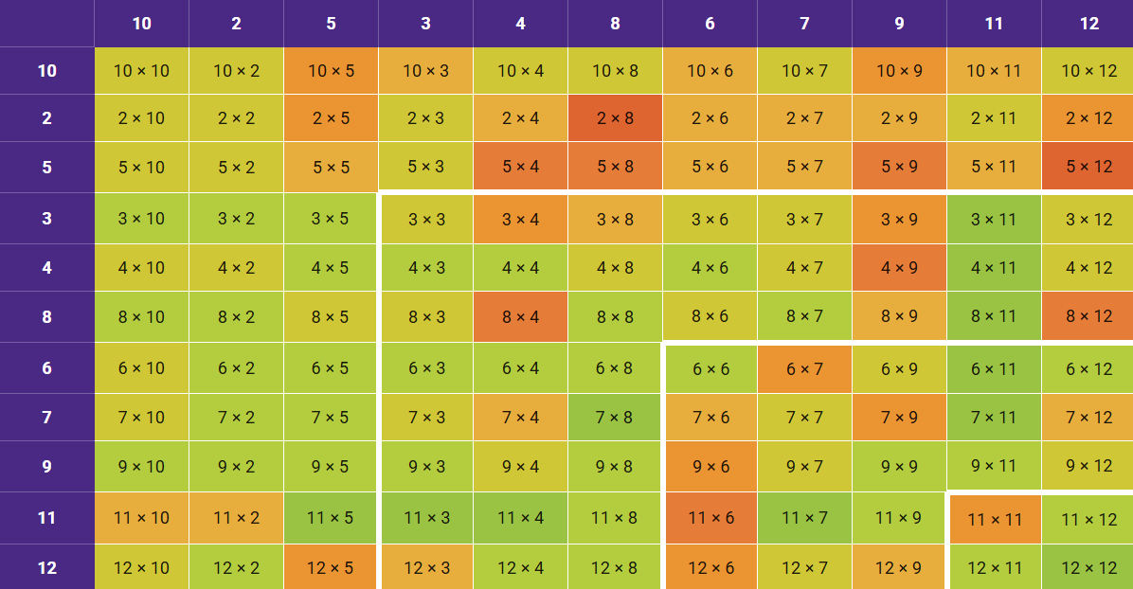

Heat map
Shows progress
Computer algorithm
Personalised
Allows for staff to intervene and support

Slide 9
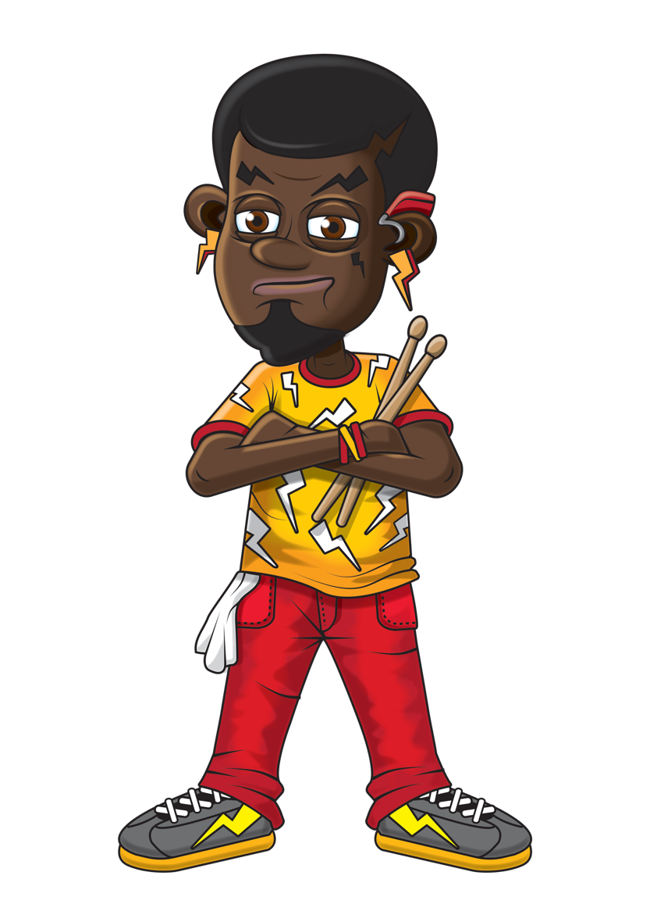

How many times should they go on TTRS?
Little and often
Using various game modes
We teach multiplication for conceptual understanding as well as speedy recalling. There is a balance of teaching within the school.

Slide 10
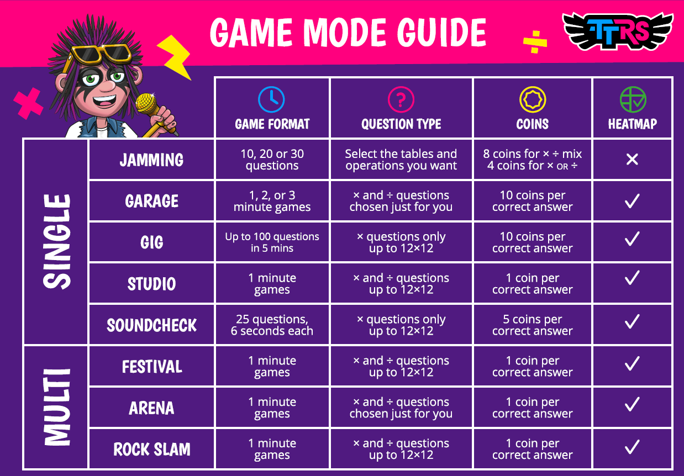
Game modes

Slide 11
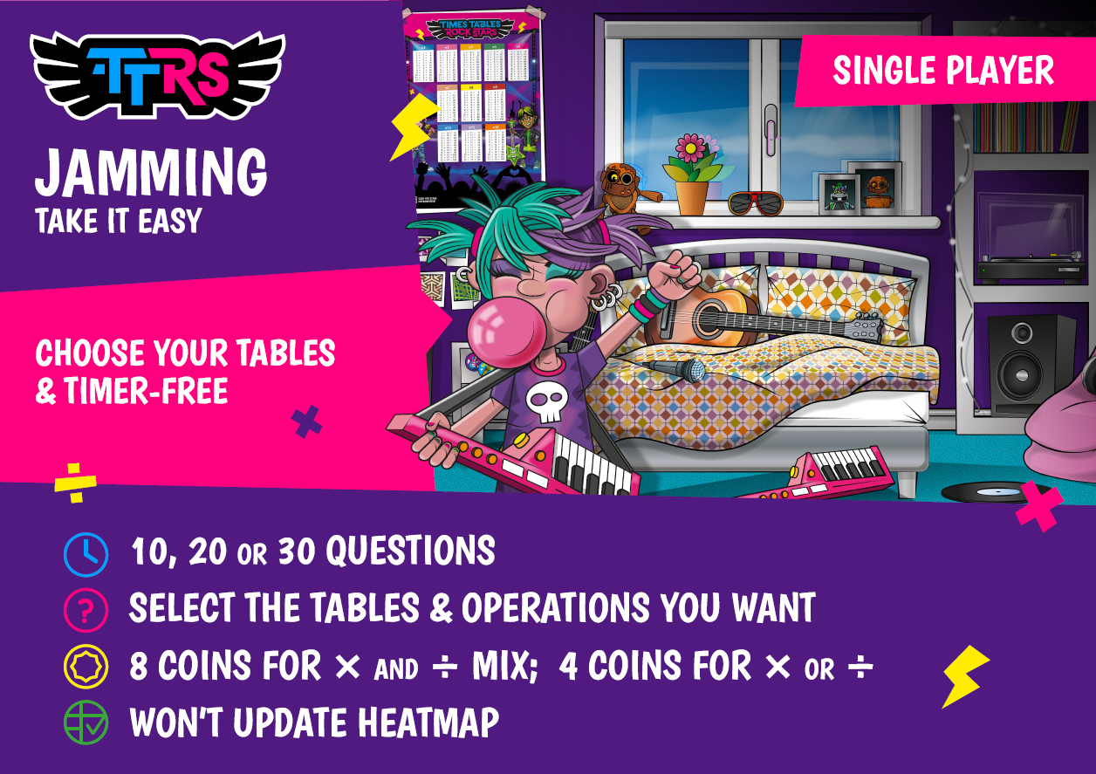
Game modes

Slide 12
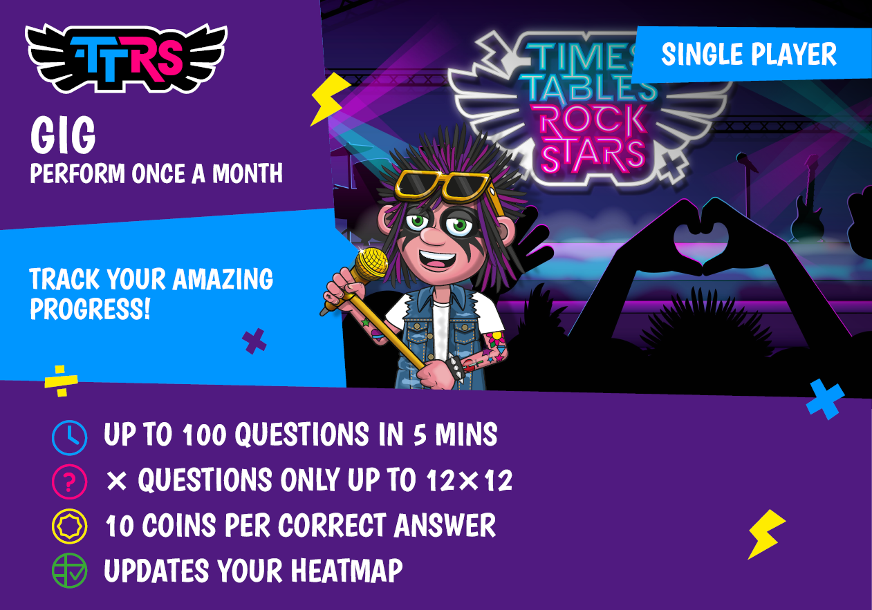
Game modes

Slide 13
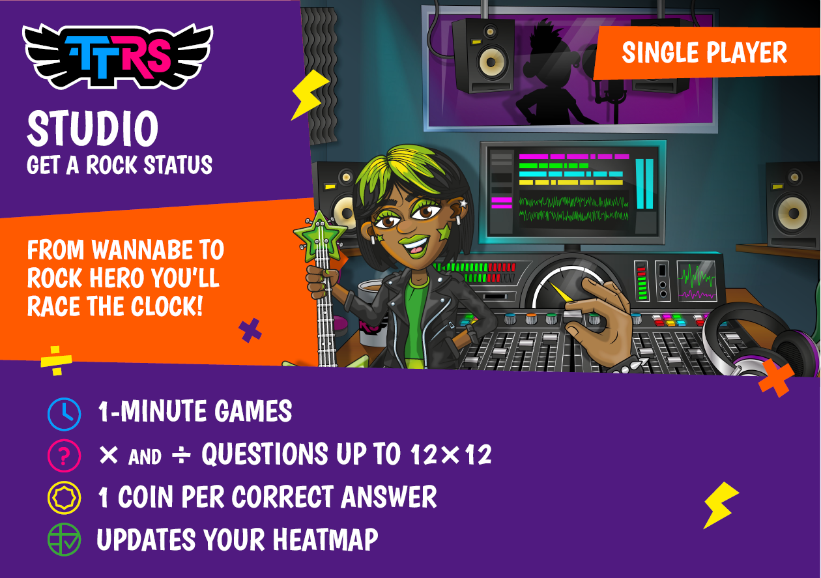
Game modes

Slide 14
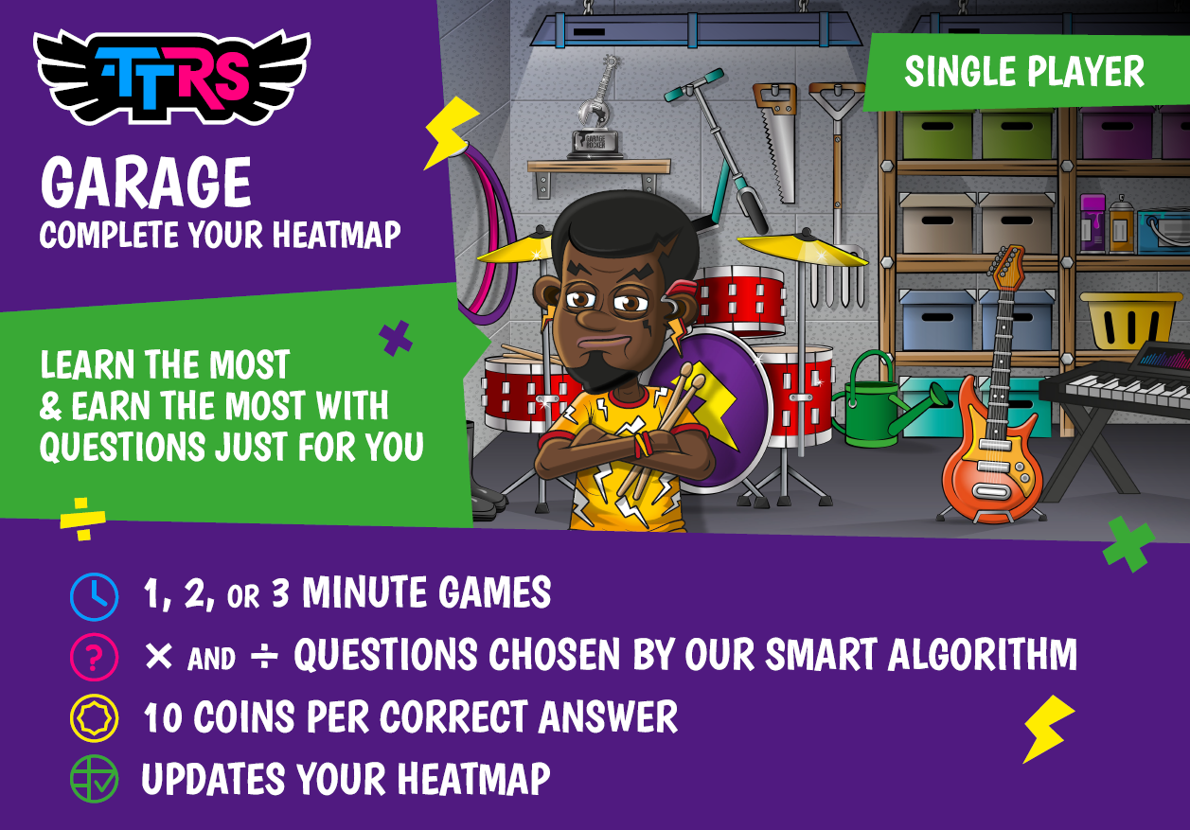
Game modes

Slide 15
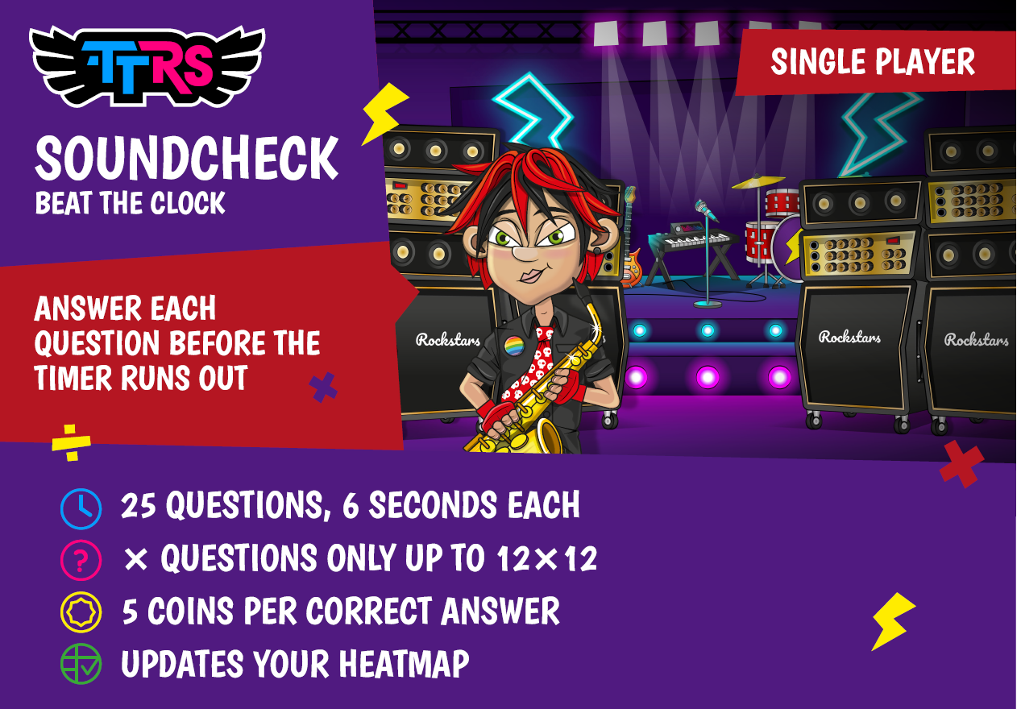
Game modes

Slide 16
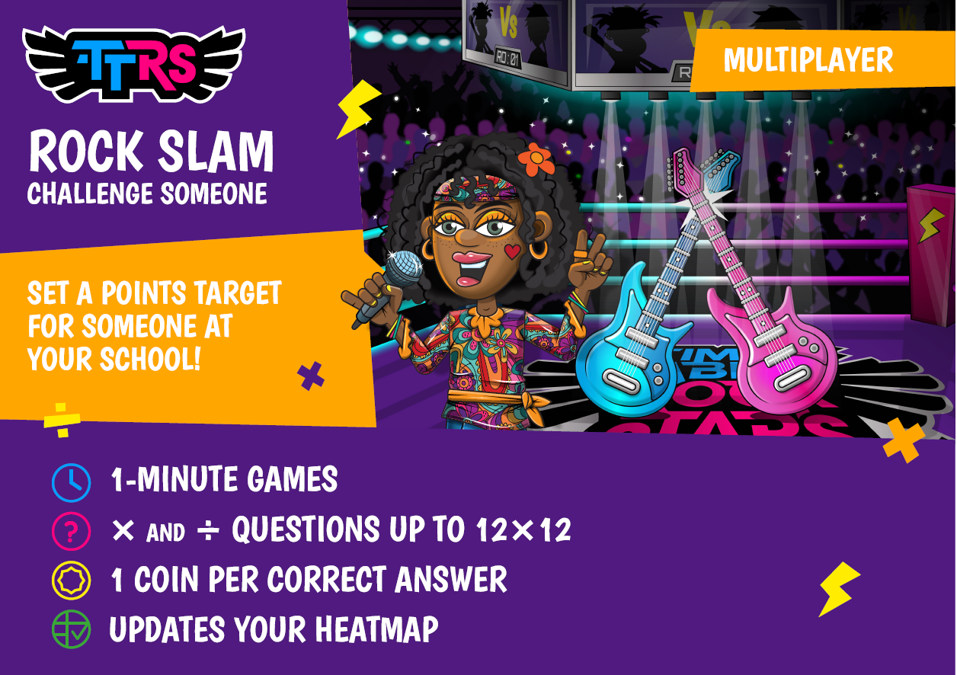
Game modes

Slide 17
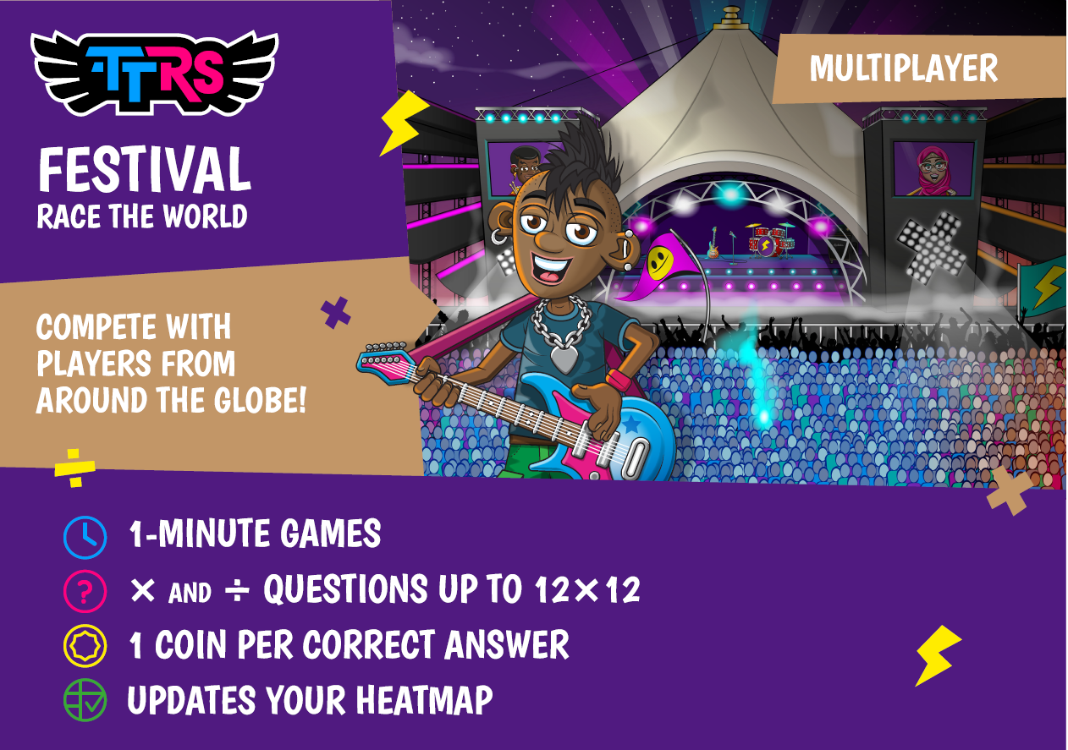
Game modes

Slide 18
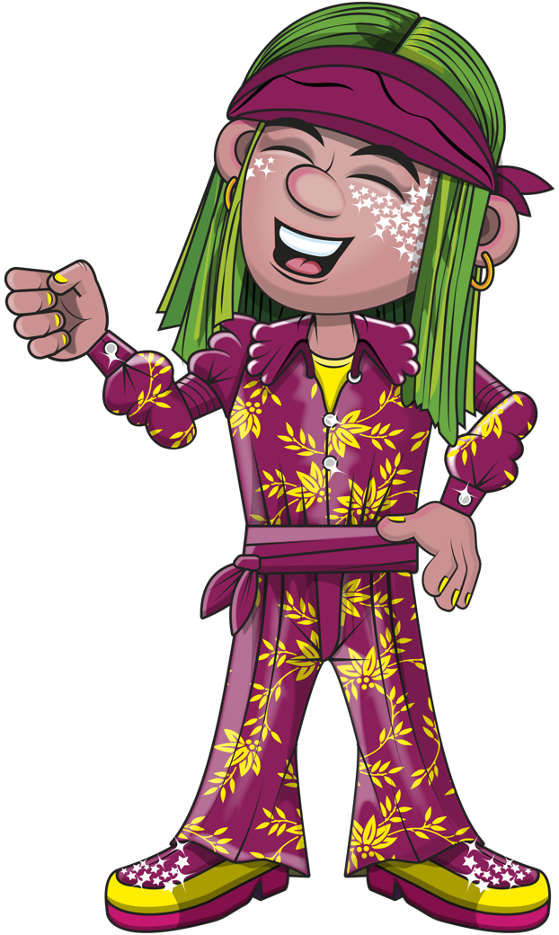
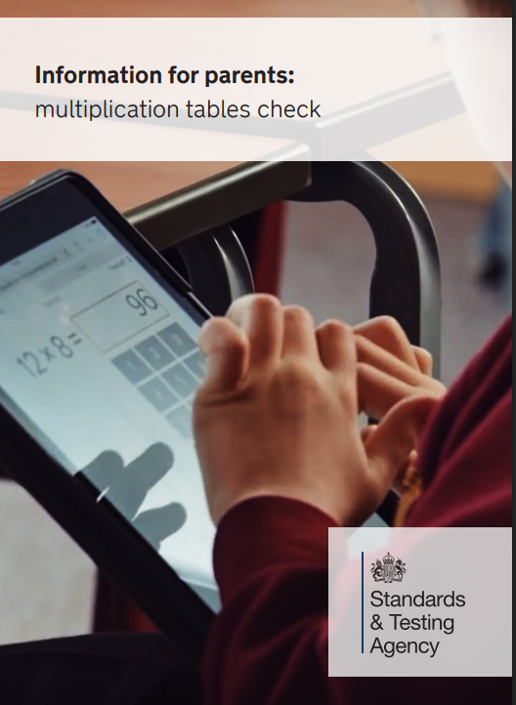
Multiplication Check at year 4
Children in year 4 are to be assessed on their multiplication skills.
This is an online assessment where they will be tested on their ability to recall multiplication facts up to 12 x 12

Slide 19
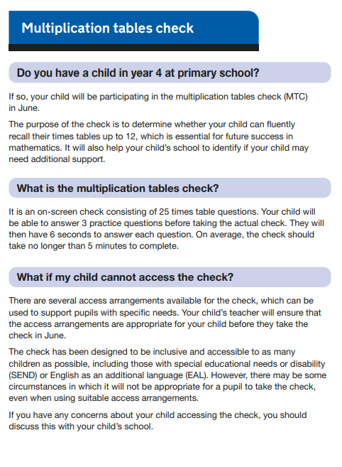
Multiplication Check at year 4

Slide 20
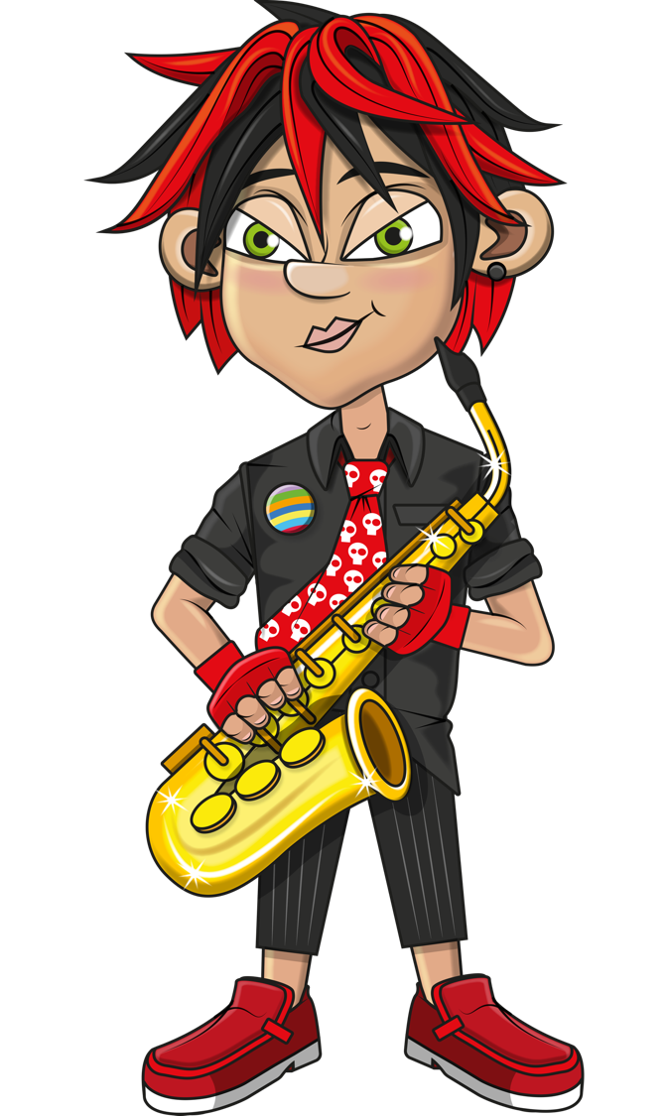
Next steps
Have a go at home. Sit alongside your child and give them plenty of encouragement.
We may send home paper activities to compliment the online work.
Come and see me if you have any questions

Slide 21


Look out for….

